Slide 1
QUIZ APPLICATION

Slide 2
TEAM MEMBERS
1
N S GAGAN - ENG19CS0194
2
NARMATHA T - ENG19CS0198
3
PAVAN B - ENG19CS0220

Slide 3
INTRODUCTION
•Providing an online comprehensive solution to manage quiz.
•The aim is to computerize the manual system, save valuable and important data.
•The data will exist for long period of time, easily accessible, and provide better service to their users.

Slide 4
PROBLEM STATEMENT
●Our Quiz Application is developed to overcome the time consuming problem of manual system in an effective manner.
●The users do not need high computing knowledge to analyse and understand the flow of the app.
●No instructors are needed to use the app.

Slide 5
OBJECTIVE
● The main aim of Online Quiz is to facilitate a user friendly environment
● This system is helpful for conducting Multiple Choice Examinations and provides immediate results saving the precious time of faculties to check the papers and give marks.
● The application will enables users to practice for subjective tests conducted for admissions and recruitment.
● Users of the system are:
1. Teachers 2. Students

Slide 6
SYSTEM
REQUIREMENTS- HARDWARE
1
64 BIT CPU
2
8+ GB OR RAM
3
GRAPHIC PROCESSOR

Slide 7
SYSTEM
REQUIREMENTS-
SOFTWARE
1
ANDROID STUDIO
2
JAVA
3
virtual device

Slide 8
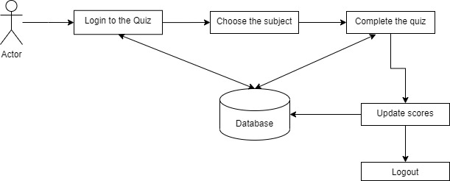
Workflow

Slide 9
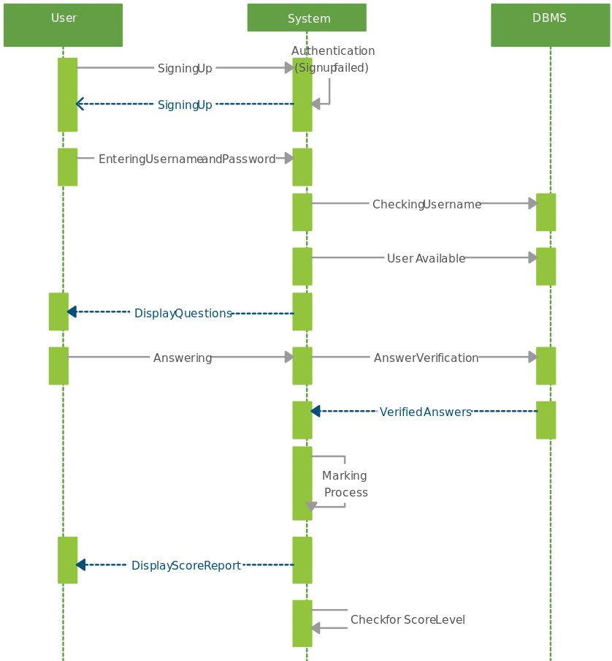
UML Diagram
Update scores to Db

Slide 10
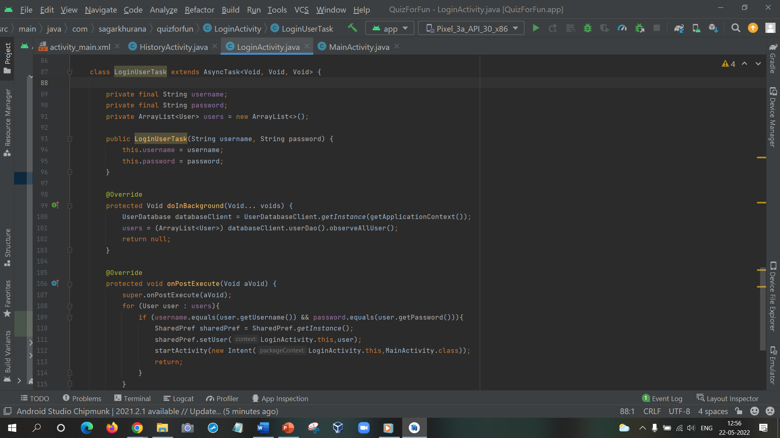
Implementation

Slide 11
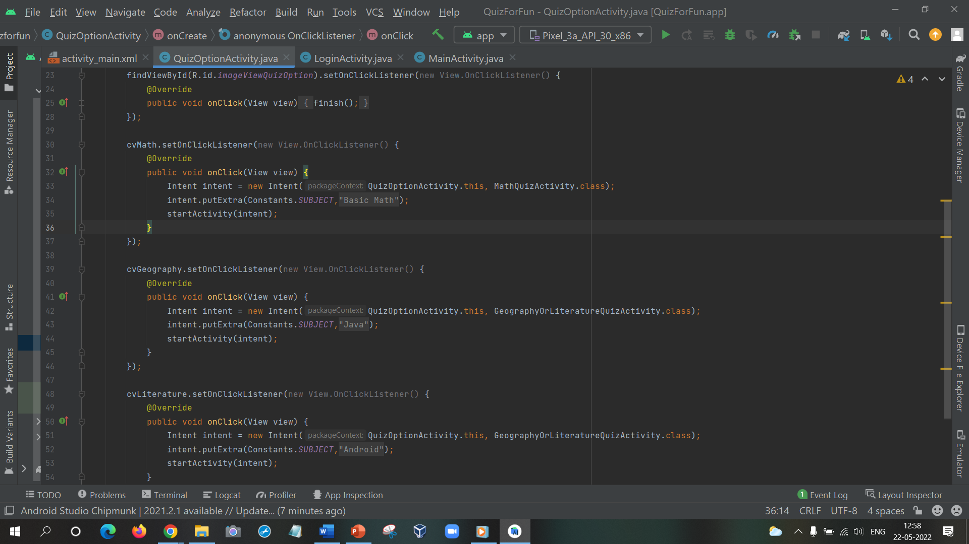
Implementation

Slide 12
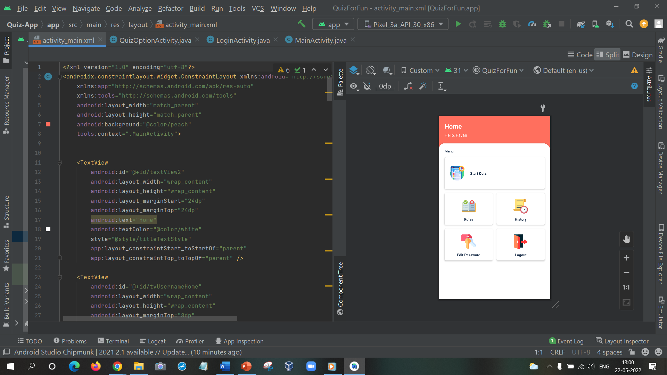
Implementation

Slide 13
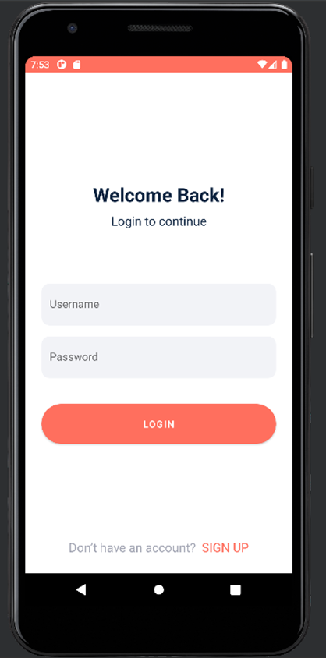
LOGIN
PAGE

Slide 14
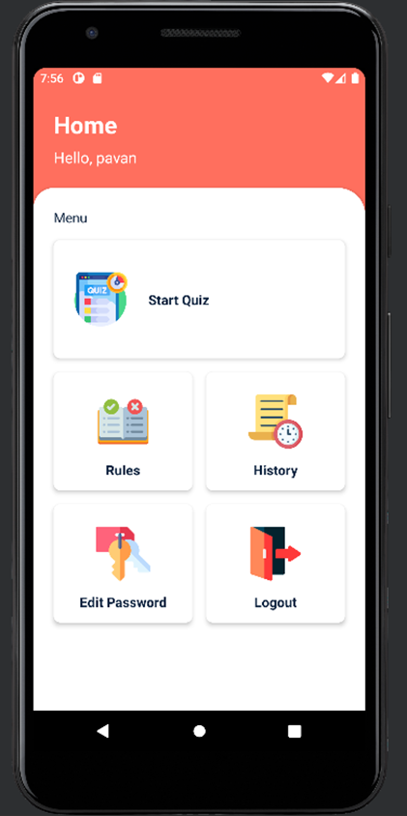
HOME
PAGE

Slide 15
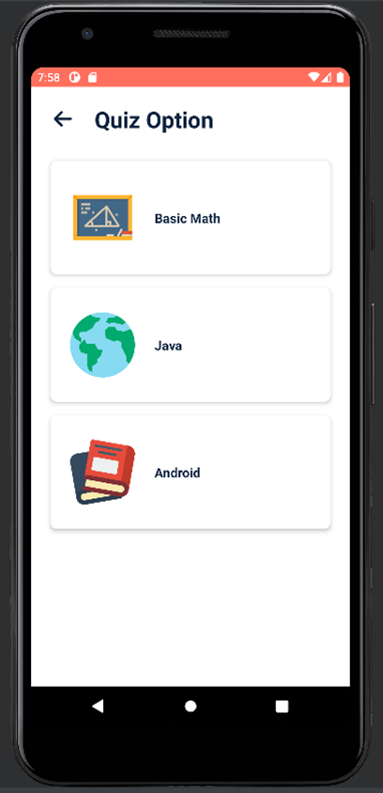
QUIZ
CATEGORIES

Slide 16
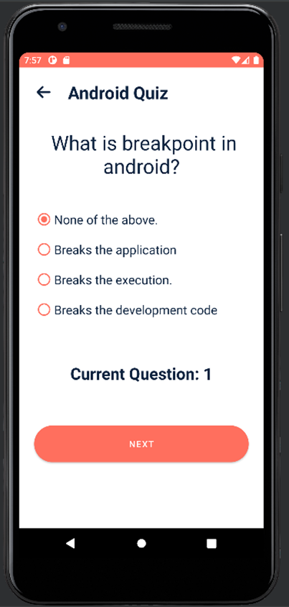
QUIZ
QUESTIONS

Slide 17
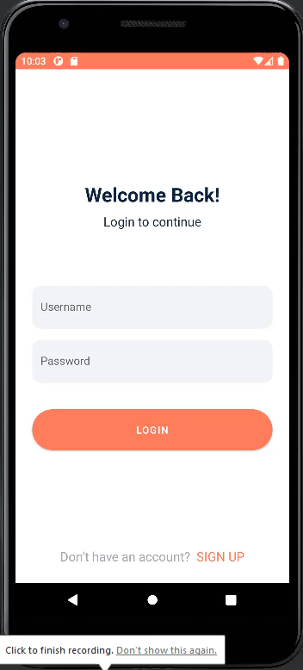
Demo of our project

Slide 18
THANK YOU

